Slide 1

React Hooks

Slide 2
React Hooks
Javascript function
Manages component states
Handles component lifecycle methods
It requires React version equivalent or greater than 16.8

Slide 3

Why hooks required in React ?

Slide 4
Need of implementation of React Hooks
To share stateful logics in spite of using HOC and render props
Complex component structure
Removes code duplications
Makes component reusable
Easily handles component life-cycle methods

Slide 5
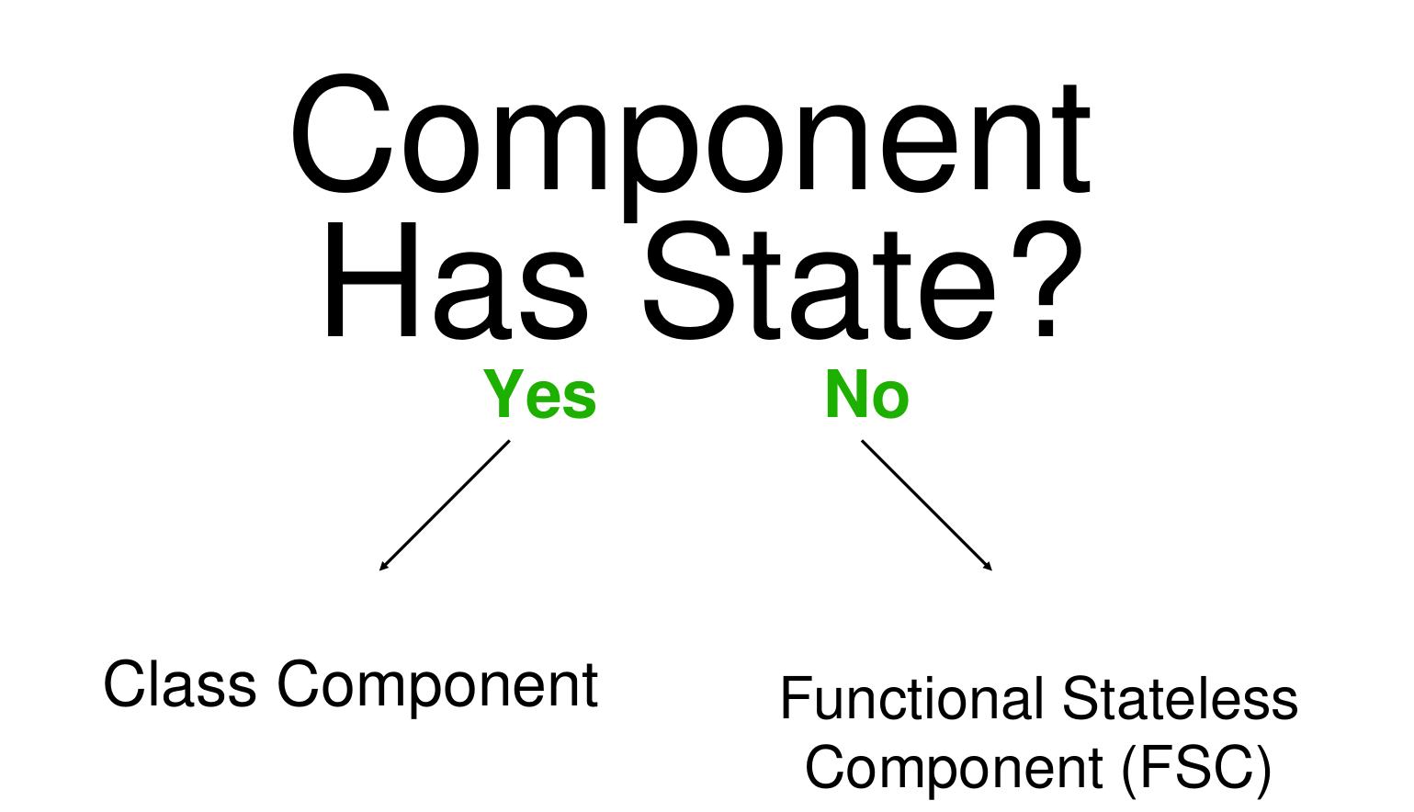

Slide 6

To share stateful logics

Slide 7
Let’s explain the two most commonly used React hooks
UseState
UseEffect

Slide 8
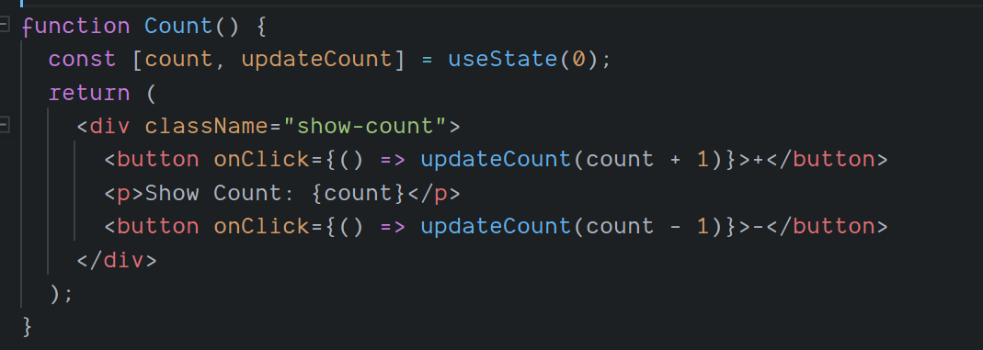
UseState
Declares state variables
Manages value of state via functional calls

Slide 9
UseEffect
Handles side effect of a component
Accepts second argument as an array to handle the side effect
Can create a callback function
ComponentDidMount
Side Effects
ComponentDidUpdate
ComponentWillUnMount

Slide 10
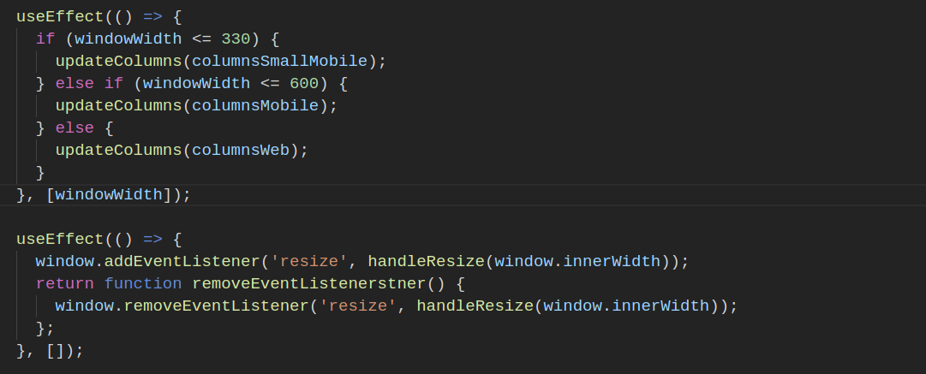

Slide 11
Custom hooks
Javascript function
Hooks name always start with “use”
Can be called in another hooks to share some common logic

Slide 12
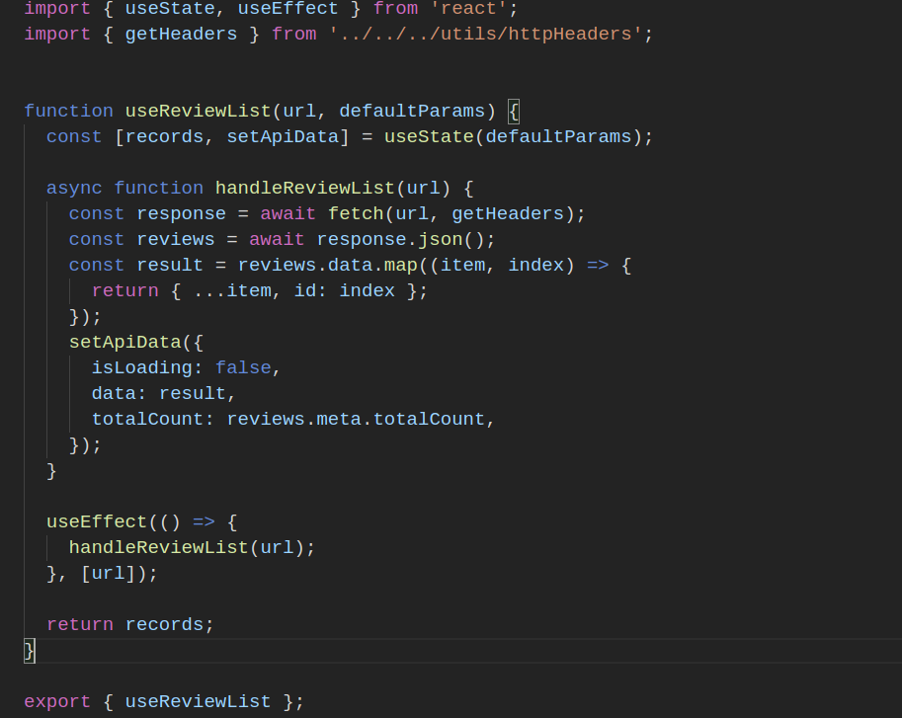

Slide 14
Rules to use hooks
Install a Eslint React hooks plugin in order to track the errors
No loops
No conditions
Always passed the value in second parameter of useEffect if you want to re-render if the value gets updated. Otherwise it will keep re render unnecessary.

Slide 15


Slide 16
Resources
https://reactjs.org/docs/hooks-intro.html
https://codesandbox.io/s/moustevent-hooks-667q8

